Slide 1
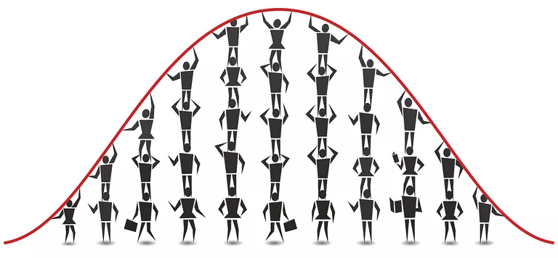
Tutorial 2 Statistics
Dr. Dvir Aran - Introduction to Bioinformatics (236523) Winter 2023-4
Almog Angel

Slide 2
Today we will talk about…
What is statistics?
Descriptive statistics (recap)
The central limit theorem
Hypothesis testing
t-test
p-values
Class exercise
Notes:
*** Download the data from the course website
*** install ggplot2 and stringi packages

Slide 3

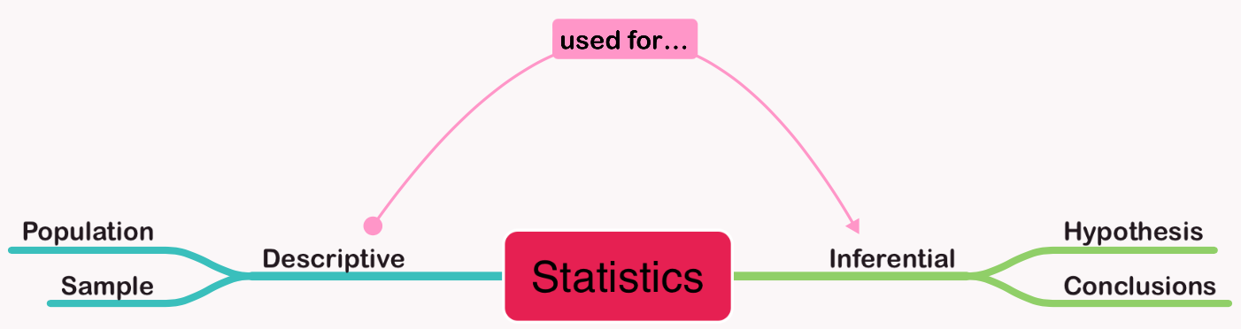

What is statistics?
Descriptive: methods that summarize, describe and visualize properties of data
Inferential: formulas that use those properties to test hypotheses and draw conclusions
Notes:
The two major areas of statistics: descriptive and inferential

Slide 4
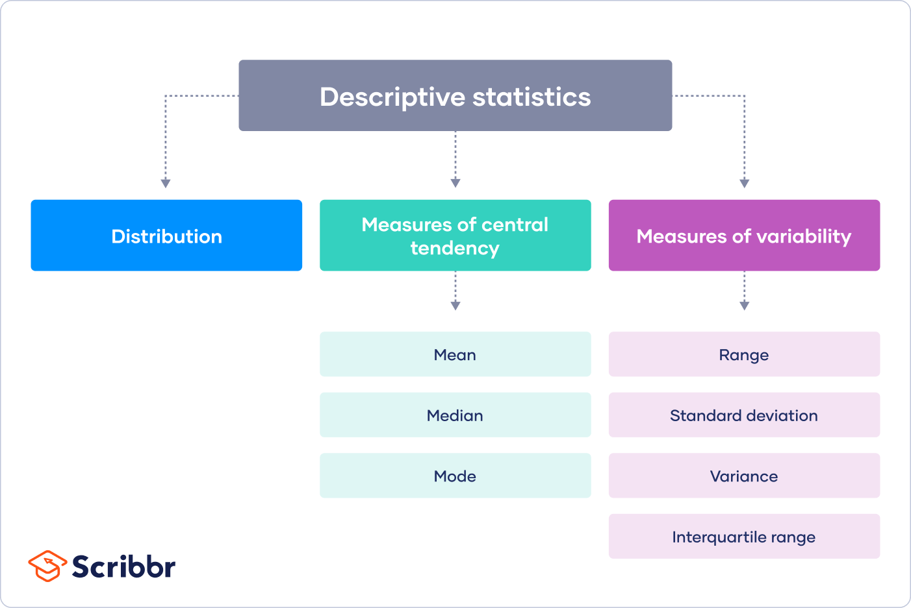
Descriptive statistics

Slide 5


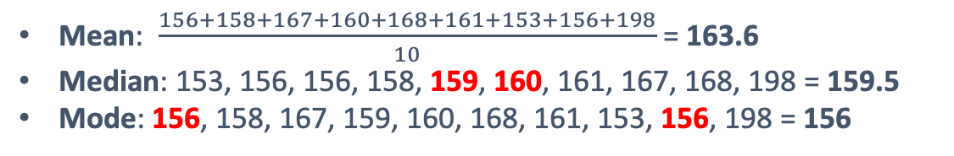
Descriptive statistics
Measures of central tendency: the descriptive summary of a dataset through a single value that reflects the center of the data distribution
How tall are humans?
156, 158, 167, 159, 160, 168, 161, 153, 156, 198 … (x8 billion)
Mean: $\frac{156+158+167+160+168+161+153+156+198}{10}$ = 163.6
Median: 153, 156, 156, 158, 159, 160, 161, 167, 168, 198 = 159.5
Mode: 156, 158, 167, 159, 160, 168, 161, 153, 156, 198 = 156

Slide 6

Descriptive statistics
Measures of variability: the descriptive summary of a dataset that is concerned with how spread out the values are.
How tall are humans?
156, 158, 167, 159, 160, 168, 161, 153, 156, 198 … (x8 billion)
Range: $[$53.3, 251.46]

Slide 7
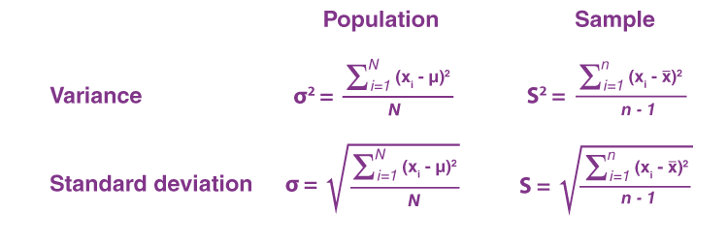



Descriptive statistics - Measures of variability
µ - population mean
X̄ – sample mean
𝞼 – population SD
S – sample SD
𝞼² – population var.
S² – sample var.
X̄ = 163.6
S² = 168.26
S = 12.971
156, 158, 167, 159, 160, 168, 161, 153, 156, 198
X̄ = 163.6
S² = 523.82
S = 22.887
133, 145, 142, 159, 160, 155, 160, 194, 200, 188
Notes:
Variance – the average degree to which each value differs from the mean
Standard deviation – the square root of the variance

Slide 8
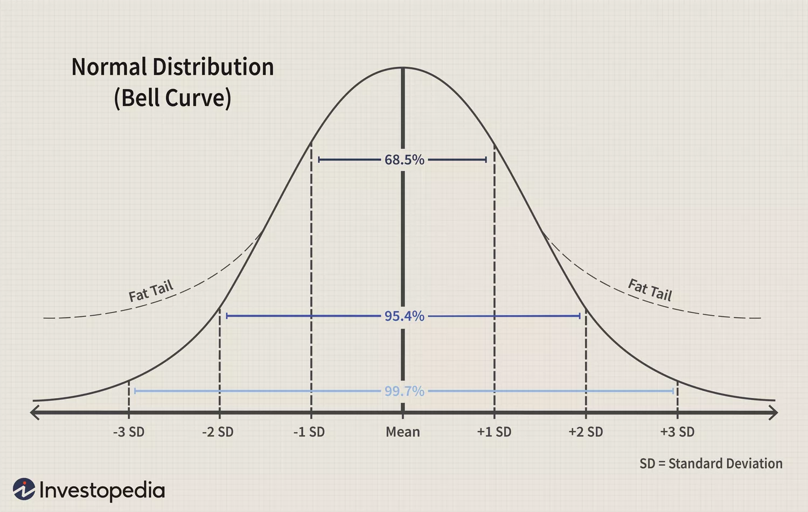

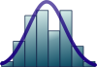
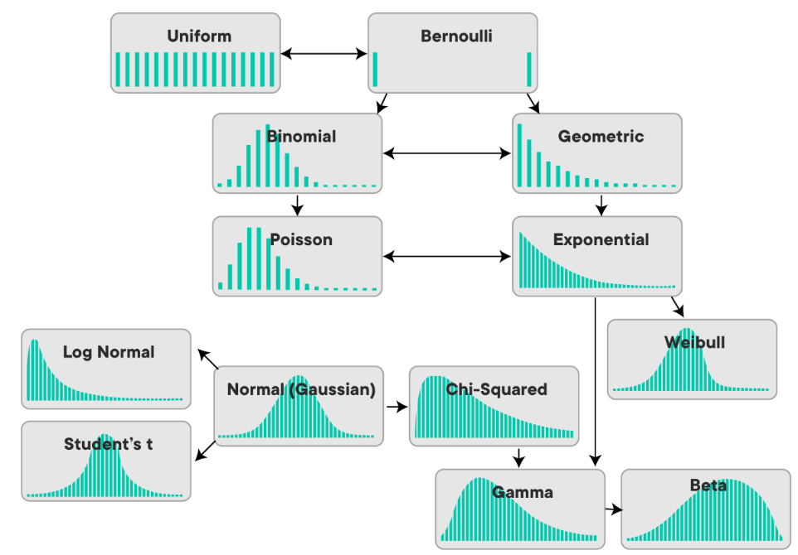
Descriptive statistics
Distribution: the descriptive of values frequency
The probability density function of a normal distribution N(0, σ2)

Slide 9
μ = population mean
X̄ = sample mean
𝞼 – population SD
S – sample SD
The central limit theorem (CTL)
Population
μ
Short
Tall
Population mean (μ)
Inferential
statistics
Sample mean (X̄)
Sample mean (X̄)
Sample mean (X̄)
Sample
Short
Tall
Notes:
Population vs. sample
Not all distributions are normal
CLT - the distribution of sample means approximates a normal distribution as the sample size gets larger

Slide 10




X̄ = sample mean
μ = population mean
S = sample SD
S² = sample variance
Inferential statistics - hypothesis testing
?
Humans living in a small wooden floored court are taller than those living in a green rectangular-shaped grass field.
<
Sample (n=45)
X̄ = 174.8
S² = 155.51
165, 173, 161, 177, 171, 194, 165, 178, 166, 198, …
Sample (n=38)
X̄ = 193
S² = 156
194, 188, 210, 186, 175, 198, 214, 197, 190, 178, …
Notes:
Decide on a hypothesis to test, often called the “null hypothesis” (H0). The null hypothesis assume that there is no anomaly in the tested population (ex. there is no difference between sets of samples).
Decide on the “alternative hypothesis” (H1). The alternative hypothesis that observation is due to real phenomena.
Decide on a statistic test that will test the truth of the null hypothesis.
Compare the result of the statistic test it to the observed value to establish significance, the P-value. Based on that, either reject or not reject the null hypothesis, H0.

Slide 11
Inferential statistics - hypothesis testing
1. Specify the Null Hypothesis
Null hypothesis (H₀): There is no difference in height between humans from soccer and basketball courts
2. Specify the Alternative Hypothesis
Alternative hypothesis (H₁): Humans from basketball courts are taller than human from soccer field (one side comparison)
Alternative hypothesis (H₁): There is a difference between heights of humans from soccer and basketball courts (two sides comparison)
3. Set the Significance Level
0.05 (5%)
4. Calculate the Test Statistic and Corresponding P-Value
Find the right statistical test (next slide)
5. Drawing a Conclusion
H₀ : μ₁ = μ₂
H₁ : μ₁ > μ₂

Slide 12
Data types
Numerical
Categorial
Nominal
Ordinal
Discrete
Continuous
Basketball/football court?
Height?
Notes:
The two major areas of statistics: descriptive and inferential

Slide 13
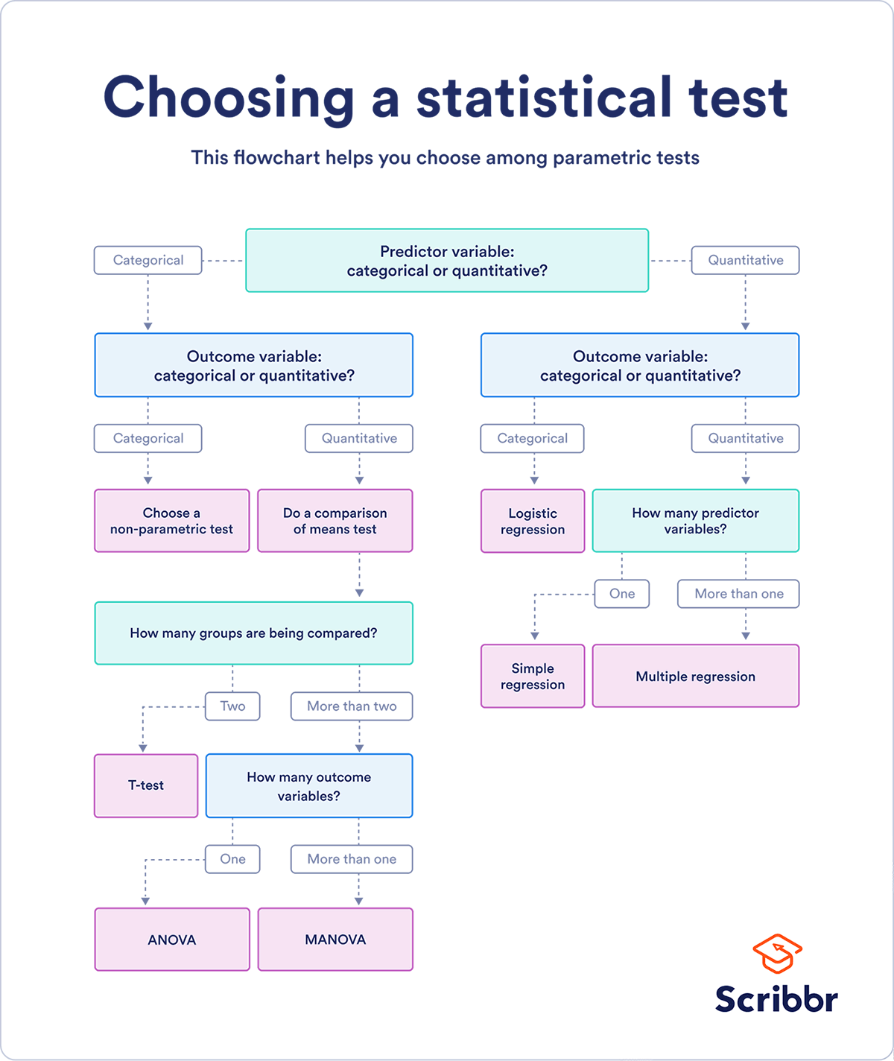
Inferential statistics - hypothesis testing
Notes:
Assumptions:
Independence of observations
Homogeneity of variance
Normality of data
Also notice:
Types of variables
Sample size

Slide 14
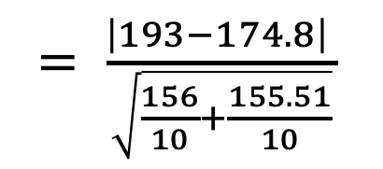
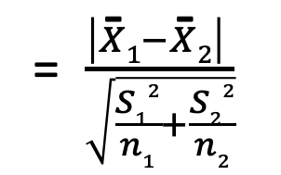
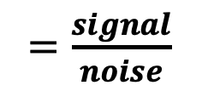
Student's t-test
Test how strong the difference (if there one) between two samples
$=\frac{signal}{noise}$
= $\frac{\left|X\text{̄}1−X\text{̄}2\right| }{\sqrt{\frac{S12}{n1}+\frac{S22}{n2}}}$
$= \frac{\left|193−174.8\right| }{\sqrt{\frac{156}{10}+\frac{155.51}{10}}}$
t-value
= 3.26
signal
X̄₂
X̄₁
noise
noise
noise
174.8
193

Slide 15
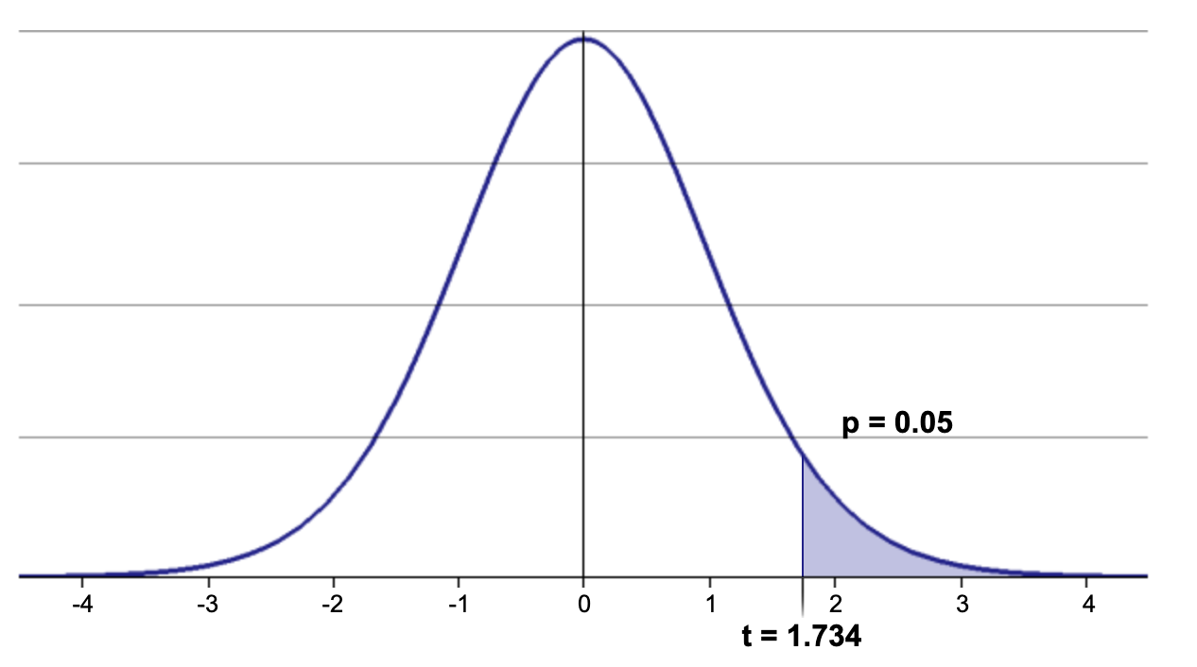
The t-distribution
The distribution of the probability to get each t-value
Degree of freedom (df) = n₁ + n₂ - 2 = 10 + 10 - 2 = 18
A critical value (p) that we set to answer the earlier
Probability
3.26
t-value
Our t-value 3.26 > 1.734, therefore we can reject the null hypothesis
Humans from a basketball court are significantly taller than humans from a soccer filed
http://www.statdistributions.com/t/?p=0.1&df=12&tail=2
Notes:
The degree of freedom determent the shape of the t-distribution curve as it approach the normal curve when n = 30

Slide 16
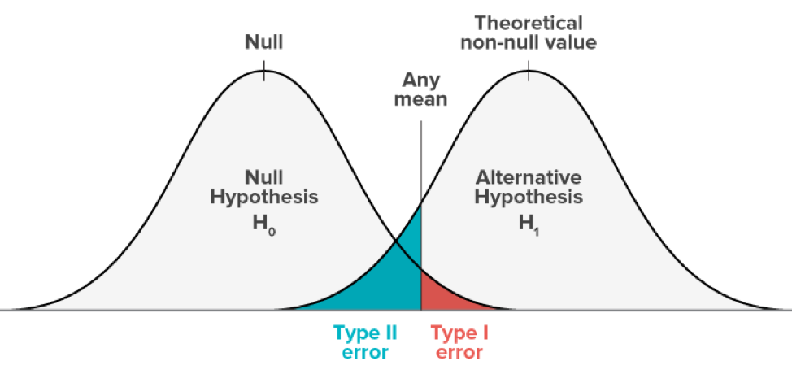
The p-value
A p-value is a measure of the probability that an observed difference could have occurred
The lower the p-value, the greater the statistical significance of the observed difference
p-values just tell you how confident you can be with your result, it is not proof!
Type I error means rejecting the null hypothesis when it's actually true (false positive)
Type II error means accepting the null hypothesis when it's actually false (false negative)
Notes:
The degree of freedom determent the shape of the t-distribution curve as it approach the normal curve when n = 30

Slide 17

P-hacking
Notes:
Define and null and alternative hypothesis

Slide 18



Class exercise
The Israeli Corona Cabinet proposed the allocation of money for a campaign to convince people to get vaccinated
However, there is not enough money for a country-wide campaign
The minister of health argue that there are fewer vaccinated people in the periphery compared to the central region
As one of the top statisticians in the country, they ask you to analyze the data and suggest whether the campaign should be focus on the periphery or not.
Notes:
Define and null and alternative hypothesis

